Slide 1
MANAGEMENT OF ABHIGHATAJANYA APABAHUKA (TRAUMATIC FROZEN SHOULDER) BY AYURVEDA: A CASE STUDY
DONE BY
DR SHUHAINA PATTUPARA
DR HANEENA NARGEES

Slide 2
ABSTRACT
Apabahuka (Frozen shoulder-FS) is a disease that affects the shoulder joint.
Frozen shoulder is also known as Adhesive capsulitis, It is characterized by pain and stiffness in the shoulder joint and upper arm muscles with restricted mobility.
Apabahuka is a Vataja vyadhi associated with Kapha dosha.
The prevalence of FS varies from 11.4% to 19% in India. FS is commonly found between 40 to 70 years and most common in females.
Various modalities are available to treat FS such as nonsteroidal anti-inflammatory drugs, corticosteroids, physiotherapy, ultrasound therapy, arthroscopic surgery or a combination of treatments, still no satisfactory results are found.
In the present case report, a 50-year-old female patient consulted with the chief complaints of pain, stiffness, restricted mobility of shoulder joint and pain while lifting weight along with disturbed sleep.

Slide 3
Patient was diagnosed as a Abhighatjanya Apabahuka (Traumatic FS).
The patient was assessed on the basis of Visual Analogue Scale (VAS). Stiffness Gradation, Tenderness Gradation and range of movements using Goniometer.
Patient was treated with Sthanika Abhyanga- Swedana and internal medication.
The outcome of Ayurvedic management of FS was encouraging to reduce subjective and objective parameters.
KEY WORDS: Apabahuka, Frozen shoulder, Abhyanga, Patra Pottali sweda.

Slide 4
INTRODUCTION
It is a disease of shoulder joint and explained in Vatavyadhi Nidana Adhyaya in Charaka Samhita,Ashtanga Hridaya and Sushrutha Samhitha.
The causative factors of Apabahuka are Abhyantara hetu (intrinsic factors such as Vata-Kapha dosha Prakopaka Ahara and Vihara) and Bahya hetu (extrinsic factor like Abhigatajanya i. e. trauma etc))which leads Vata Prakopa and gets lodged in shoulder joint leading Sira Sankocha and ultimately causing Bahupraspandanahara (loss or impaired movement of shoulder joint).
The Apabahuka can be correlated with frozen shoulder disease. Frozen shoulder also known as adhesive capsulitis, is a disabling disease of the shoulder causing pain and restricted mobility of the shoulder joint. It is a painful inflammatory process of the shoulder joint.
The present case study will explore the efficacy of Ayurvedic treatment in the management of Frozen shoulder which is difficult to cure by many treatment modalities available in contemporary system of medicine. Hence the aim of this case study was management of Frozen shoulder by using various treatments available in Ayurveda to manage Vatavaydhi. The Shamana (Amapachana). Shodhana (Vatanulomana). Patrapindapottali sweda (Kaphavilayana and Vatashamana) and Lepa (to remove localized ama ) treatment were used and significant relief was observed by this treatment.

Slide 5
CASE REPORT
A 50-year-old female patient consulted OPD of Parul Ayurveda Hospital, Vadodara, Gujarat with complaints of pain in right shoulder joint leading to difficulty in lifting of weights with right arm and disturbed sleep for 1 month.
History of present illness
A moderately built 50-year-old female housemaker, presented with complaints of pain and difficulty in movement of her right shoulder joint for 1 month but severity was increased since last 10 days. Before 1 month, she met with a road accident-causing pain in the right shoulder joint. For this, she was taken to the hospital where basic investigations like X-ray were done. As X-ray appeared to be normal, she was prescribed with analgesics. Her pain, however, was not subsiding and was increasing with daily routine activities. The severity of her pain was so much that she was unable to sleep properly which was affecting the quality of her life. Hence, she came to Parul Ayurveda hospital.

Slide 6
CLINICAL FINDINGS
No known case of any chronic illness like diabetes, hypertension etc.
On general examination, the patient was afebrile and her blood pressure, heart rate and respiratory rate was within normal limits.
On systematic examination, no abnormality was found in the cardiac, respiratory, and gastro intestinal system.
Muscle power was elicited 3/5 in the right upper limb, 5/5 in the left upper limb, and 5/5 in both lower limbs.
On Local examination of the right shoulder joint findings were tenderness at the lateral and posterior aspect of the right shoulder joints (+++) on palpation.
On inspection, no abnormalities were seen.
.

Slide 7
All Range of motion of the right shoulder joint was painful and restricted.
On the goniometer, degrees of abduction and adduction movements were reduced to 45 degrees with pain.
Apley scratch test and drop arm test were positive.
With the above findings and observations, we diagnosed it as a case of Abhigatajanya Apabahuka (Adhesive capsulitis). X ray shoulder joint was done to rule out other pathology and it was normal.
The patient was admitted to IPD for further management

Slide 8
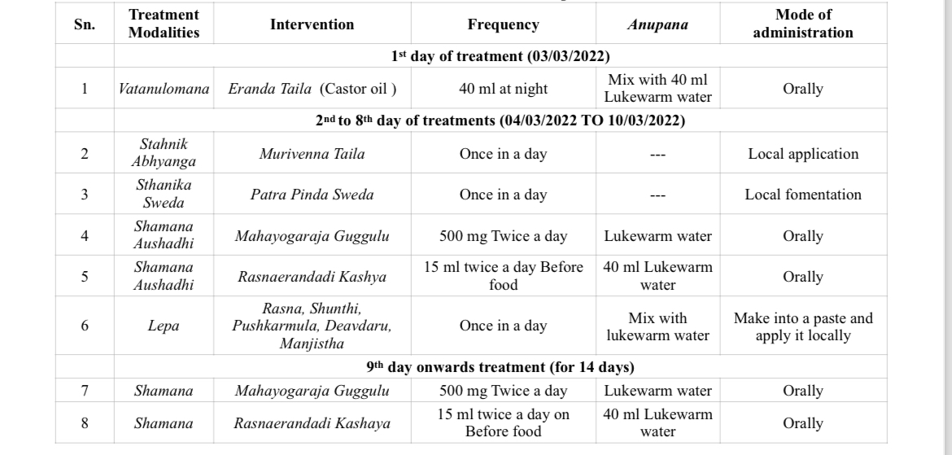
TREATMENT PLAN ADOPTED

Slide 9
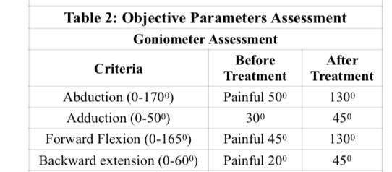
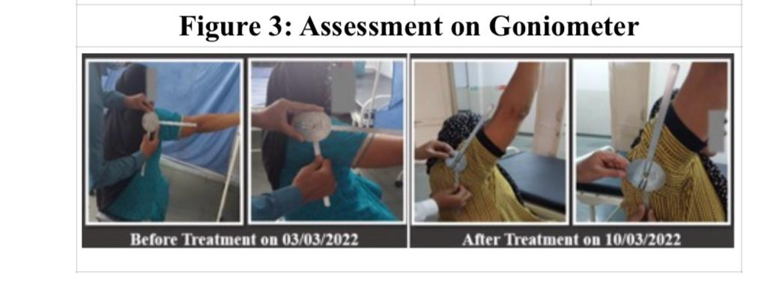
RESULTS
The result of treatment was assessed on the basis of Visual Analogue Scale (VAS), Stiffness, Tenderness Gradation, and Range of Movements using a Goniometer. Before and after treatments were assessed and it is described in Figure 1, 2 and 3.

Slide 11
DISCUSSION
Apabahuka is the one among the Vatavyadhi which is explained in Ayurveda classics, caused by kupita Vata dosha affecting the Amsa-Pradesha and does the Akunchana of Sira ultimately leading to Bahupraspandanahara (Difficulty in the movement of the shoulder joint).
In the present study with the help of the above clinical findings and causative factors, it was diagnosed as Abhighatajanya Apabahuka (Traumatic frozen shoulder) and in modern science, it can be correlated with Adhesive capsulitis.The exact pathophysiology of adhesive capsulitis is unknown.
The inflammation is followed by reactive fibrosis and adhesions of the synovial lining of the joint.The most commonly accepted hypothesis states that inflammation initially occurs within the joint capsule and synovial fluid. The inflammation is followed by reactive fibrosis and adhesions of the synovial lining of the joint. The initial inflammation of the capsule leads to pain, and later the capsular fibrosis and adhesions are formed leading to a decreased range of motion in the joint.
Frozen shoulder often progresses in three stages: the freezing (painful), frozen (adhesive) and thawing phase.

Slide 12
In the freezing stage, which lasts about 2-9 months, there is a gradual onset of diffuse, severe shoulder pain that typically worsens at night
The pain will begin to subside during the frozen stage with a characteristic progressive loss of glenohumeral flexion, abduction, internal rotation and external rotation. This stage can last for 4–12 months.
During the thawing stage, the patient experiences a gradual return of range of motion that takes about 5–26 months to complete. (8, 9, 10)
The choice of treatment can vary with patient factors, stage at presentation and clinician preferences. Nonsurgical or conservative management is the preferred choice of treatment.
Conservative treatment options include analgesics, oral steroids, physical therapies, hydro dilatation, suprascapular nerve block (SNB) and intraarticular steroid or sodium hyaluronate injections.
Surgical treatment is offered to patients with persistent symptoms despite conservative management; strategies include manipulation under anesthesia (MUA), arthroscopic release and open release

Slide 13
In Ayurveda, the management is focused on Vataprakopshamaka through Panchakarma and internal medication.
For the Sampraptivighatana (to break the pathology) of Apabahuka the medicines should possess a Shophahara (Anti-inflammatory), Vedanashamaka (Analgesic), Dhatuposhaka (Nourishes to tissue), Snigdha (Unctuous) and Vatakaphahara properties
Murivenna Taila is the mixture of eight distinct drugs with coconut oil serving as the base. Majority of these drugs having Vatakaphahara properties, which reduces the pain and stiffness.
Tambula (Piper betle Linn) and Kumari (Aloe Vera Tourn ex Linn) also have Pittashamaka properties, which reduces inflammation, alleviate pain and tenderness. (13, 14, 15)
Patra Pottali Sweda given here, helps in reducing pain, stiffness and swelling of the affected joint. It’s mainly due to Patra having Vatahara and shothahara (~anti-inflammatory) properties as well as UshnaSuksham (hot-penetrating) Guna of Swedana Karma (sudation therapy) leading to reduction in shoola,(pain) sthamba (stiffness) and Bahuoraspandana. (impaired shoulder movement)

Slide 14
Mahayogaraja Guggulu is a compound Ayurvedic formulation comprising powders of herbal ingredients processed with Guggulu .The main therapeutic action as vedanasthapaka and shothahara which is attributed by the presence of Guggulu as the major ingredient.
Rasnaerandadi Kashayam is having Trikasoolahara.Shulaprashamana and Shophagna properties which was given as an Anupana for Mahayograj Guggulu.
Sthanika lepa (Local Paste) was administered on the Cervical region to the upper limb (Right) to provide relief from pain and Stiffness. The herbal ingredients used in lepa possess Vata pacifying. Shothahara, and Vedanashamaka properties.
Subjective parameters assessment was done by VAS (Visual Analogue Scale), suggestive of 7 score before treatment which came down to 1 after treatment.
Objective parameters was assessed with the help of Goniometer showing the marked improvement.All the restricted and painful movements became normal and painless.
90% relief was noted in subjective as well as objective parameters. within 8 days of treatment. Remaining 10% relief was noted by continuing 14 days of Shamana Aushadhi.

Slide 15
CONCLUSION
In this case of FS, management was done by Sthanika Abhyanga-Swedana and Shamana Aushadhi. Treatment showed highly significant relief in pain, stiffness, and restricted painful movement of the right shoulder. The FS is effectively managed by Ayurvedic treatment principles of Vatanulomana, Sthanika Abhyanga, Swedana, Lepa and Oral medications to break the Vatakaphaja samprapti of Apabahuka. Study should be carried out on a number of patients to extrapolate the same line of treatment for Apabahuka.

Slide 16
REFERENCE
Yadav T. Charaka Samhita. Ayurveda Deepika commentary by Chakrapani data, 4th Edition. Varanasi; Chaukhamba Orientalia publisher; 1994. 8-9 p.
Tripathi B. Astangh Hridaya of Srimadvagbhata, 3rd edition. Delhi; Chaukhamba Sananskrit Pratishthan; 2017.542p.
Jayson MI. Frozen shoulder: adhesive capsulitis. British medical journal (Clinical research ed.). 1981; 283(6298); 1005-1006.
Ricci M. Adhesive capsulitis: A review for clinicians. Journal of the American Academy of Physician Assistants. 2021; 1;34(12), 12-4. 4.
Hannafin JA, Chiaia TA. Adhesive capsulitis: a treatment approach. Clinical Orthopedics and Related Research®. 2000; 1; 372, 95-109.
Manske RC, Prohaska D. Diagnosis and management of adhesive capsulitis. Current reviews in musculoskeletal medicine. 2008; 1 (3-4). 180-189. 6.
https://www.ncbi.nlm.nih.gov/books/NBK532955/ dated 10-04-2020 time 14:10 IST
Chan HB, Pua PY, How CH. Physical therapy in the management of frozen shoulder. Singapore medical journal. 2017; 58(12), 685.

Slide 17
Prestgaard TA, Fields KB, Grayzel J. Frozen shoulder (adhesive capsulitis). Retrieved January. 2012; 10(2012)1-27.
Dias R, Cutts S, Massoud S. Frozen shoulder. British medical journal. 2005; 331(7530); 1453-1456.
Georgiannos D. Markopoulos G, Devetzi E, Bisbinas I. Adhesive Capsulitis of the Shoulder. Is there Consensus Regarding the Treatment? A Comprehensive Review. The Open Orthopaedics Journal 2017; 11; 65-76
Date A, Rahman L. Frozen shoulder: overview of clinical presentation and review of the current evidence base for management strategies. Future Science OA. 2020; 6(10); 647.
Gauttam J, Bhatted S, Yadav U. Management of Spondylosis Induced Sciatica through Panchakarma wsr to Vata Kaphaja Gridhrasi-A Case Study. Journal of Ayurveda and Integrated Medical Sciences, 2019; 4(04); 366-370.
Ghodela NK, Prasad P, Dudhamal TS. Clinical Efficacy of Murivenna oil Parisheka in the management of soft tissue injury wsr to achillis tendinopathy-A case study. European Journal of Biomedical. 2017; 4(6); 496-498.
Hepsibah PT, Rosamma MP, Prasad NB, Kumar PS. Standardisation of murivenna and hemajeevantitaila. Ancient Science of Life. 1993; 12(3-4): 428.
Kumbar P, Rajput L, Singh G. Ayurvedic Management of Frozen Shoulder (Apabahuk)- A Case Report. International Journal of Ayurvedic Medicine 2021; 12(2): 416-420.

Slide 18
THANK YOU

